Slide 1
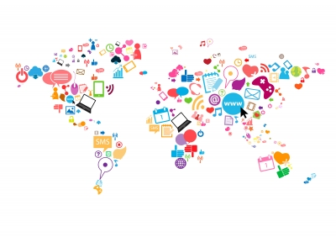
Group 2 - The Ethics of Online Campaigns
University of Maryland, University College
Professor Howard Stugard
IFSM 304 - 6981
03/16/2017
Group members:
Surtej Sarin - Group Leader
Clayton Harrison
Christian Temple
John P. Lomeli
Kyron Engram
Romaric Posset
Corey Banaszak

Slide 2

Overview
The advent of Social Media has provided a real-time, virtual, and global means of communication.
These platforms allow users to create, join, and participate in communities of interest (COI) e.g. political, fashion marketing, and etc.
Within the communities people, groups, and advocates (such as designers, or product makers) have the ability to reach like-minded people, or even possibly potential customers on a large scale.
Social media platforms enable real time campaigns to exist online with very little governance, which occasionally brings ethical questions into play.
Notes:
Social Media has created a plethora of different models for communicating to large groups of people that previously would have to be reached by antiquated standards such as focus group time slots for television, radio, and newspaper. Some examples of social networking sites include, AOL, Facebook, MySpace, Reddit, Tumblr, and Twitter. Social Media provides a platform for like minded people into online communities and groups. The instantaneous propagation of information has allowed the establishment of collectivism; people are promoting their wants and expectations into online campaigns, and are having an impact on issues by mass appeal. For example, in the 2008 presidential campaign Barack Obama’s team utilized their online presence to” organize volunteers, to find new supporters and put them to work, to turn out voters on election day and (of course) to raise unprecedented amounts of money — all contributing to a crucial edge in the primary and general elections” (Delany, 2009). At the same time, social media can present ethical and privacy issues e.g. the recent scandal with Marines Unite, a group with over 30,000 active duty and veteran Marines and British Royal Marines, that established a campaign to share private, intimate pictures of women in various states of dress without their knowledge (Mclaughlin & Stapleton, 2017).

Slide 3
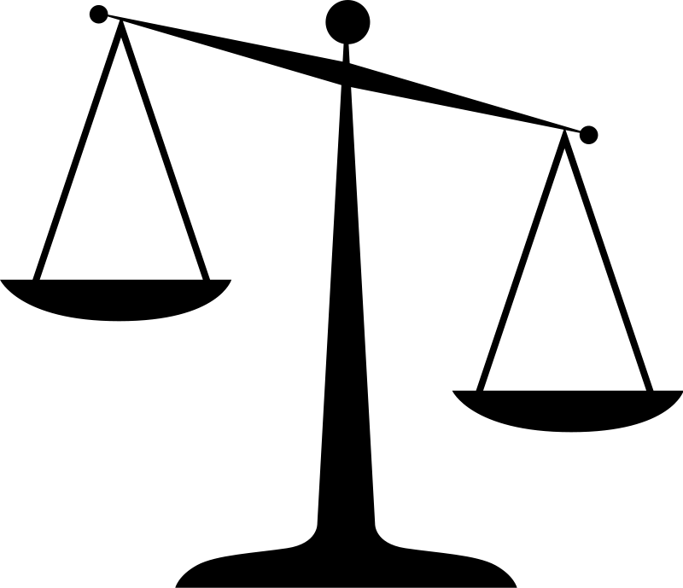
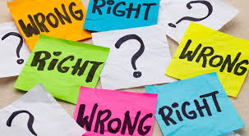
Ethical Topics
Freedom of speech
Validating information
Intentionally misleading
Is instant always better?
Privacy concerns
Authors/information providers
Anonymous posts
Cyber bullying/shaming
Notes:
Online campaigns and social media technologies are growing and bringing many ethical questions into the fold. This presentation seeks to discuss the ethical issues surrounding online information and public usage of this information. The topic, in question: are online campaigns ethical?
The following points/slides will be covered in the presentation:
1. Freedom of speech – laws regarding the dissemination of online information in social media
2. Validating the information presented on social media (verify before you testify)
3. Intentionally misleading the community – how information in social media can be misleading and examples of this in communities of interest (COI)
4. Is instant always better – looking at the effects of obtaining information from online social networking sites as opposed to traditional news i.e. academic journals, libraries, news print
5. Verifying the credibility of authors/information providers
6. Anonymous posts – controversial implications and effects of this and examples in bulletin board systems, internet forum, or other discussion forums
7. Cyber bullying/shaming – how social media and online communities have caused a rise in bullying and unacceptable behavior

Slide 4


Rationale
Far reaching effects of online campaigns
Changing demographic of user communities
Rapid adoption for instant news and information
Increase in online forums
Individuals’ privacies are affected
Anonymity is preserved
Influence through public polling
More court cases surrounding social media
Notes:
Online campaigns and social media sites, are a current global phenomenon. Online campaigns are used globally and have a widespread impact on fields such as politics, social, business, humanitarian, science, health, and awareness. For example, the Women’s March, the largest gathering of organized protestors in U.S. history, with crowds in cities like DC, New York, San Francisco, all of the 50 states, and other major countries, started from groups created on Facebook. According to an article by The Guardian, “a third of 18-24 year-olds think social media will influence their vote, according to results of a poll by Ipsos Mori”, in the U.K (Sedghi, 2015). The amount of people who have gained online access has grown, and has led to the spread of ideas and views. Moreover, like minded individuals have created online communities on sites such as Reddit and Quora. Social media encourages community participation, allows for more targeted ads, allows for anonymity, and provides instant news and information to users. However, social media and online campaigning has also caused concerns in regards to people's security, decision in public polls, litigation and legal trials, the workplace settings, and privacy.

Slide 5
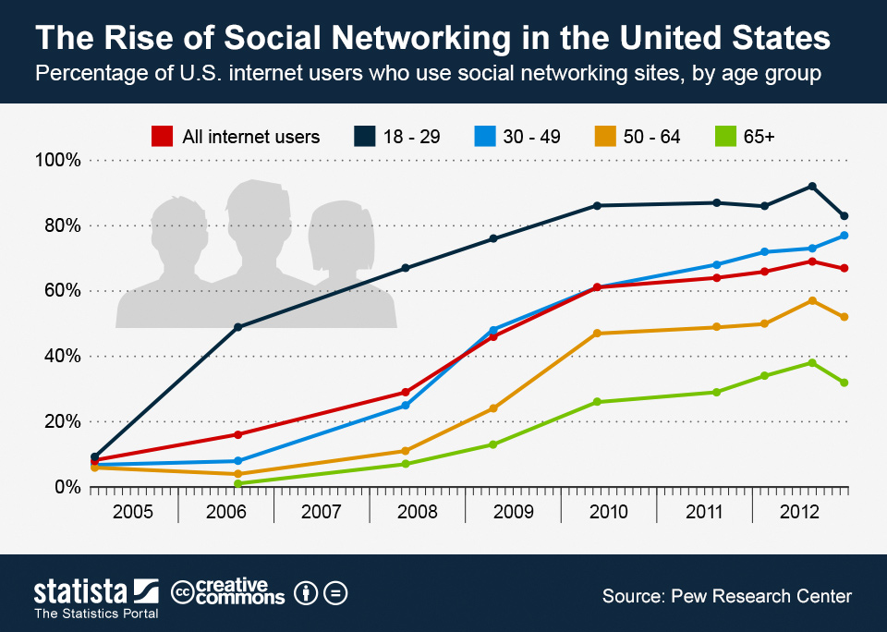
Notes:
The usage of social media and online campaigns have become increasingly popular over time, especially for young people, as a resource to connect and share information. “In August 2006, 49 percent of American internet users aged 18-29 were social network users” (Richter, 2013). In 2016, about eight-in-ten, or 79%, of Americans used Facebook (Greenwood, Perrin, & Duggan, 2016). And in 2018, there will be around 3 billion social media users worldwide.

Slide 6
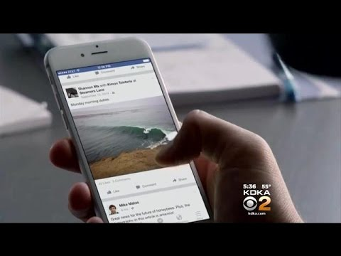
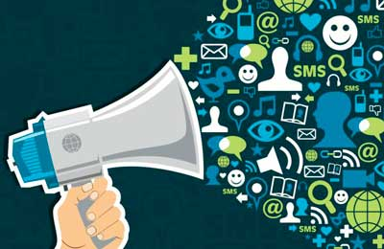
Freedom of speech
Laws governing social media
Section 512(c)
Section 230 of the Communications Decency Act
CDA 230
The Federal Trade Commission (FTC)
Court Cases
A.B. v. State
Elonis v. United States
CBS News on Elonis v. United States court case, 2015
on 18 U.S.C. § 875(c)
Notes:
Freedom of speech is a right in the U.S. Constitution. Section 512 section c, on Limitations on liability relating to material online, covers copyright infringement laws. Section 230 of the Communications Decency Act, states “No provider or user of an interactive computer service shall be treated as the publisher or speaker of any information provided by another information content provider” (47 U.S.C. § 230). This has allowed users to participate in social networking sites like Facebook and upload videos to sites like YouTube. CDA 203, is a law that legally protect bloggers from not being held accountable for comments by readers or information sent or received through RSS feeds. The Federal Trade Commission (FTC), oversees and enforces privacy policies for social media sites in the U.S and makes sure that companies are not exploiting individual privacies. These rights apply to online platforms, and a number of court cases have resulted from defamatory comments, search and seizure, privacy issues, criminal offences, civil disputes and copyright infringement. Some notable cases include A.B. v. State, U.S. v. Brown, Elonis v United States, and Stewart v. State of Iowa. In the court case of A.B. v. State, “The State of Indiana filed a delinquency petition against a Greencastle Middle School student who had posted derogatory and "vulgar" criticism of the school's anti-body-piercing policy on the social networking site MySpace” (DMLP Staff, 2008). The video covers the Elonis v. United States court case ([CBS Pittsburgh], 2015). In Elonis v. United States, a historic decision was made by The Supreme Court, which had reversed the conviction of the man from Pennsylvania who had used violent language and threats against his estranged wife on Facebook. This decision made it difficult to prosecute people for threats made on social media, thereby upholding the freedom of speech.

Slide 7
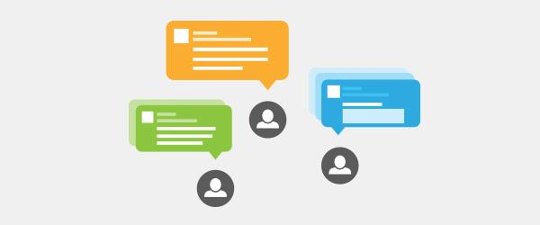
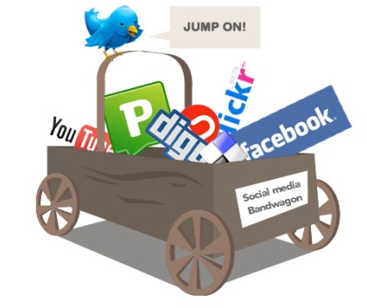
Validating the information presented (verify before you testify)
Points to consider:
Location of the source - are they in the place they are posting info about?
Network - who is in their network/who follows them? Do I know this account?
Content - can the information be confirmed from other reputable sources?
Contextual Updates - do they usually post/tweet on this topic?
Age - what is the age of the account? Be wary of recently created accounts
Reliability - Is the source of information reliable?
Source: Johns Hopkins University
Notes:
Social media can provide instant news faster than traditional news or sources with great wealth of information, however one needs to verify to determine the accuracy of the published information. With the information being provided so quickly, it does not always seem to be accurate.
Being able to identify credible information on social media is challenging with rumors and misinformation spreading quickly through sites such as Twitter and Facebook (“Guides: Evaluating Information: Evaluating Social Media”, 2016).

Slide 8

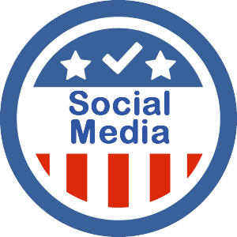
Validating the information presented (verify before you testify)
“Bots” are being used to create fake accounts to attract follower
Experiment/Research: 9 Twitter bots were able to attract an average of 62 followers over 3 week period
Result: Use of bots confirmed how easy it would be to influence news via social media.
Presidential Candidates, as well as other political figures, use social media as a direct line to voters
18 to 29 year olds use social media to learn new information about politics
Notes:
According to Johns Hopkins University, bots are being used to influence the news via social media outlets. There was an experiment conducted where nine twitter accounts were created where bots were able to attract an average of 62 followers over a three week period. This confirmed how easy it might be for someone to be influenced through these social media outlets.
Pew Research center released a study showing that people with in the age of 18 to 29 years of age used social media for current events in politics (Lang, 2016).

Slide 9


Intentionally misleading
Theories behind communities of Practice
Communities of practice are everywhere. They consist of one of the ways in which experiential learning, social constructivism, and connectivism can be combined, illustrating the limitations of trying to rigidly classify learning theories (Bates, 2014)
Clickbait articles published and shared without verification
Intentionally fabricated news
Online blogs and forums are subjective
Misleading ads and marketing communications
Notes:
With the increase and spread of information on the internet, it has become difficult for readers to discern what information is factual. Moreover, celebrities, news, and organizations have influenced the public through social media. For instance, articles written by Tech Times, Eco Watch, and Science Alert, falsely linked the spread of the Zika virus and microcephaly to Monsanto corporation (Fraley, 2016). Fake news violates and takes advantage of this fact and can be extremely detrimental to our privacy and democracy. Due to the multitude of news sources out there, many of which are not verified on Facebook and Google, makes it difficult for both naïve and knowledgeable people to deem a source as true or false just by verifying the contents its articles. For example, an armed man entered a Washington, D.C. pizzeria, Comet Ping Pong, after he had heard a fictitious online news story from ““4Chan, an Internet message board known as a gathering place for those with extreme beliefs and the place the conspiracy theory took hold” on Hillary Clinton and her campaigns involvement with child abuse (Samuelson, 2016). Additionally, other online blogs and forums, which are subjective and opinionated, can influence naive people, who may think these sources are factual. On the other end of the spectrum, advertising companies are using social media to market their products and/or services. In the U.K. the Chartered Institute of Marketing (CIM), the largest professional marketing organization in the world, has been urging marketing companies to regulate misleading marketing. According to Competition and Markets Authority (CMA), falsifying reviews and paying for endorsements online, without revealing this practice to consumers, is both harmful and unlawful. This presents an issues as, according to MarketingTech, “62% of people said they use social platforms for advice before making a purchase decision” (Daly, 2016).

Slide 10

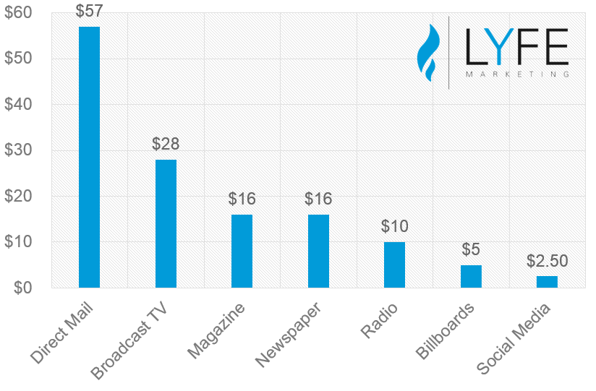
Is instant always better?
Information obtained via social media can be misleading and is sowing confusion.
Ethical Issues:
Unreported Endorsements
Improper Anonymity
Compromising Consumer Privacy
Using the online community to obtain free work
Content stays forever
Cost per thousand impressions (CPM) of various media channels
Notes:
News stories not presented in its entirety cause a great deal of confusion about the basic facts and current issues. People are divided in what they consider the most positive and negative attributes of news media. Social media reporting is often manipulated to change the psychological perception of people. Biased opinions are perpetuated due to the reinforcement of people's opinions and ideology presented via social media. The graph above shows that social media is financially less expensive than traditional media (Fou, 2014). There is also a negative side to instant information. Unreported endorsements means that companies pay bloggers without disclosing that information to their followers. For example, the “PR agency Edelman supported two bloggers road tripping across the U.S. writing positive stories about Wal-Mart through the organization Working Families for Wal-Mart” (Vinjamuri, 2012). Improper anonymity discusses how some companies try to discredit their competitors on online forums as anonymous entities or persons. For example, John Mackey, Whole Foods CEO, had admitted to discredit competitor Wild Oats online through the use of an anonymous name (Vinjamuri, 2012). Companies like Google, DoubleClick, and Facebook are using “more relevant offers and brands waste less on poorly targeted advertising”, by obtaining its users personal information and this cane compromise consumer privacy. Additionally, some companies are using the online community to obtain free work, without crediting sources which has led to copyright infringement. Lastly, content posted online stays forever and can be easily accessible to the government, future employers, and criminals.

Slide 11
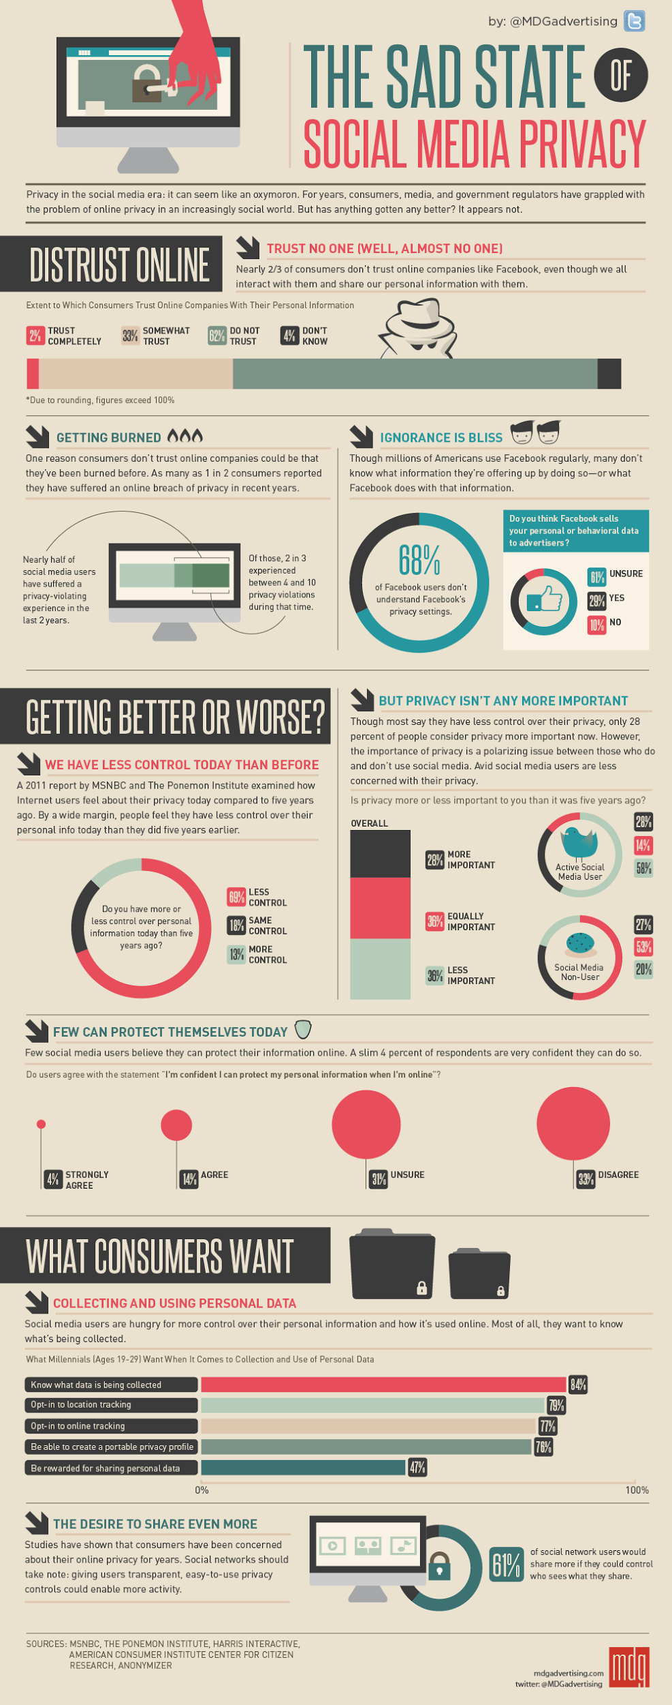
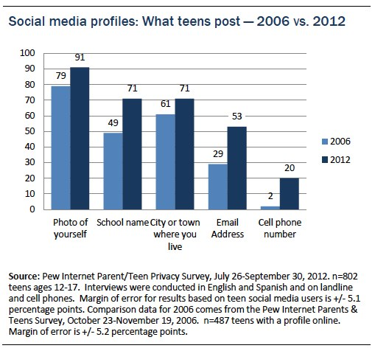
Privacy concerns
Social media and the workplace
Personal identity
Notes:
Due to the concern about the disclosure of personal information on social media sites, numerous privacy laws have been enacted in the U.S. in the past couple of years. While employees want to protect their private social media accounts and pages, “employers argue that access to personal accounts is needed to protect proprietary information or trade secrets, to comply with federal financial regulations, or to prevent the employer from being exposed to legal liabilities” ("Access to Social Media Usernames and Passwords", 2017). Furthermore, privacy is affected when companies use their customers data to sell. Choicepoint was sued $15 million in civil penalties as a result of providing personal information to identity thieves (Bosworth, 2012). The first major first step preventing companies from misusing online personal data. Personal identity is at risk when people chooses to share their information on social media. According to a Pew Research Poll, there was a 90% increase in teens providing their cell-phone numbers on social media from 2006 to 2012, as shown in the graph titled, “Social media profiles: What teens post - 2006 vs. 2012 (Madden, Lenhart, Cortesi, Gasser, Duggan, Smith, & Beaton, 2013).
Link to image: http://www.mdgadvertising.com/blog/wp-content/uploads/2012/02/the-sad-state-of-social-media-privacy-infographic.png

Slide 12

Authors/Information Provider Verification
Research Authors and Groups that Start the Campaigns
Determine Bias or Financial Motives
Check Reviews
How Recent the Campaign and if it is still Relevant
Author or Group's Reputation and Credentials
Scholarly Peer Reviewed
Notes:
Online campaigns are extremely valuable due to the rate this information can be distributed. Exposure online can spread at a very fast rate using social media or sharing content. This can also have negative effects ethically if the online campaign is not credible. Campaigns can have motives that don’t align with what is on the surface. It is important to verify the authors and groups to determine if the campaign is trustworthy. This can be done fairly quickly by determining the six steps listed here.

Slide 13
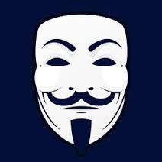


Anonymous posts
Anonymous posting versus covering tracks
Anonymous sites versus non-anonymous sites
Benefits and issues with the current state of anonymous posting
Laws governing Anonymity around the world
Real life examples and attempts by companies to mitigate anonymous posts
Rise of anonymous organizations and online entities
Notes:
One of the most powerful aspects of the internet aside from the spread of information to everyone, is the ability to express yourself anonymously. Now anonymous online can mean multiple things, first it can describe one posting in online forums and sites under a pseudonym, and the other being able to move and work through the internet without someone being able to locate or prove you have done anything online. With those who are posting online under the guise of a pseudonym there comes up sites that are anonymous friendly and allow you to post with a user name or pseudonym and not reveal their actual information, some of these sites include 4chan and reddit. Then you have sites such as Twitter and Facebook that try to use personal information to put forth an identity to people’s posts. With Facebook they use email verification and do some checks to user names checking for dictionary words and not allowing users to use them in their name. Twitter on the other hand has a verification process that people can use that allow their twitter page to have more authority in online postings.
Anonymous posting is a true double edge sword in our time this is because it is such an important tool for the common man to organize, comment, and circumvent freedom of speech violations in the event a government becomes to oppressive, but at the same time major problems have arisen from anonymous posting, things such as cyber bullying, cyber crime, and terrorist recruiting and organizing. Around the world there have sprung up laws in response to anonymous posting in cyberspace. Most of these laws are in response to the negative ethical implications of anonymous posting. So far America has still been open due to anonymous posting being covered by the first amendment, but other countries like China, Russia, Turkey, and Iran have all shut down access to sites that allow for anonymous posting. This has had two consequences, first in those countries the government has tracked people by their IP and arrested them due to their online posting, and the other being new and emerging tech being created to circumvent the issue of privacy which will eventually allow for greater anonymous posting.
Anonymous posting is seen as a problem by many people, so much as overlooking its positive value. So many companies are trying to mitigate the anonymity of the user and have been trying to tie an identity to posts. One such example of this is Youtube.com. YouTube used to allow anonymous posting, but with that came cyberbullying and quickly people have equated the YouTube comments section as a place for vile hateful comments. To try to circumvent this in 2013 YouTube implemented a policy requiring all posters to register with google+ and then login in to be able to post. The problem is people just created fake accounts and began posting hate again. This process has slowed down the amount of negative posts, but work still needs to be done if that is their end goal.
Finally internet anonymity can be perfectly personified by the group anonymous that has sprung up in the past decade. Anonymous represents what the internet’s power can be under a group that does little to nothing due to organizational failures. This means that the power of the internet is show cased in that the group is decentralized, has no leader, and yet still invokes reactions and pushes agendas. In terms of actual work or attacks by the group (which is a cyber hacktivist group) they have done very little. That being said they still show a model for this and future generations that the internet can be a critical tool to organize and push back against ethics violations of governments.

Slide 14
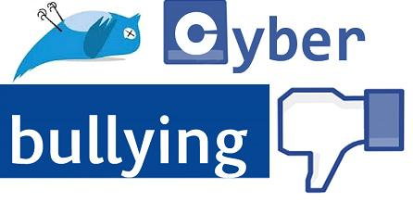
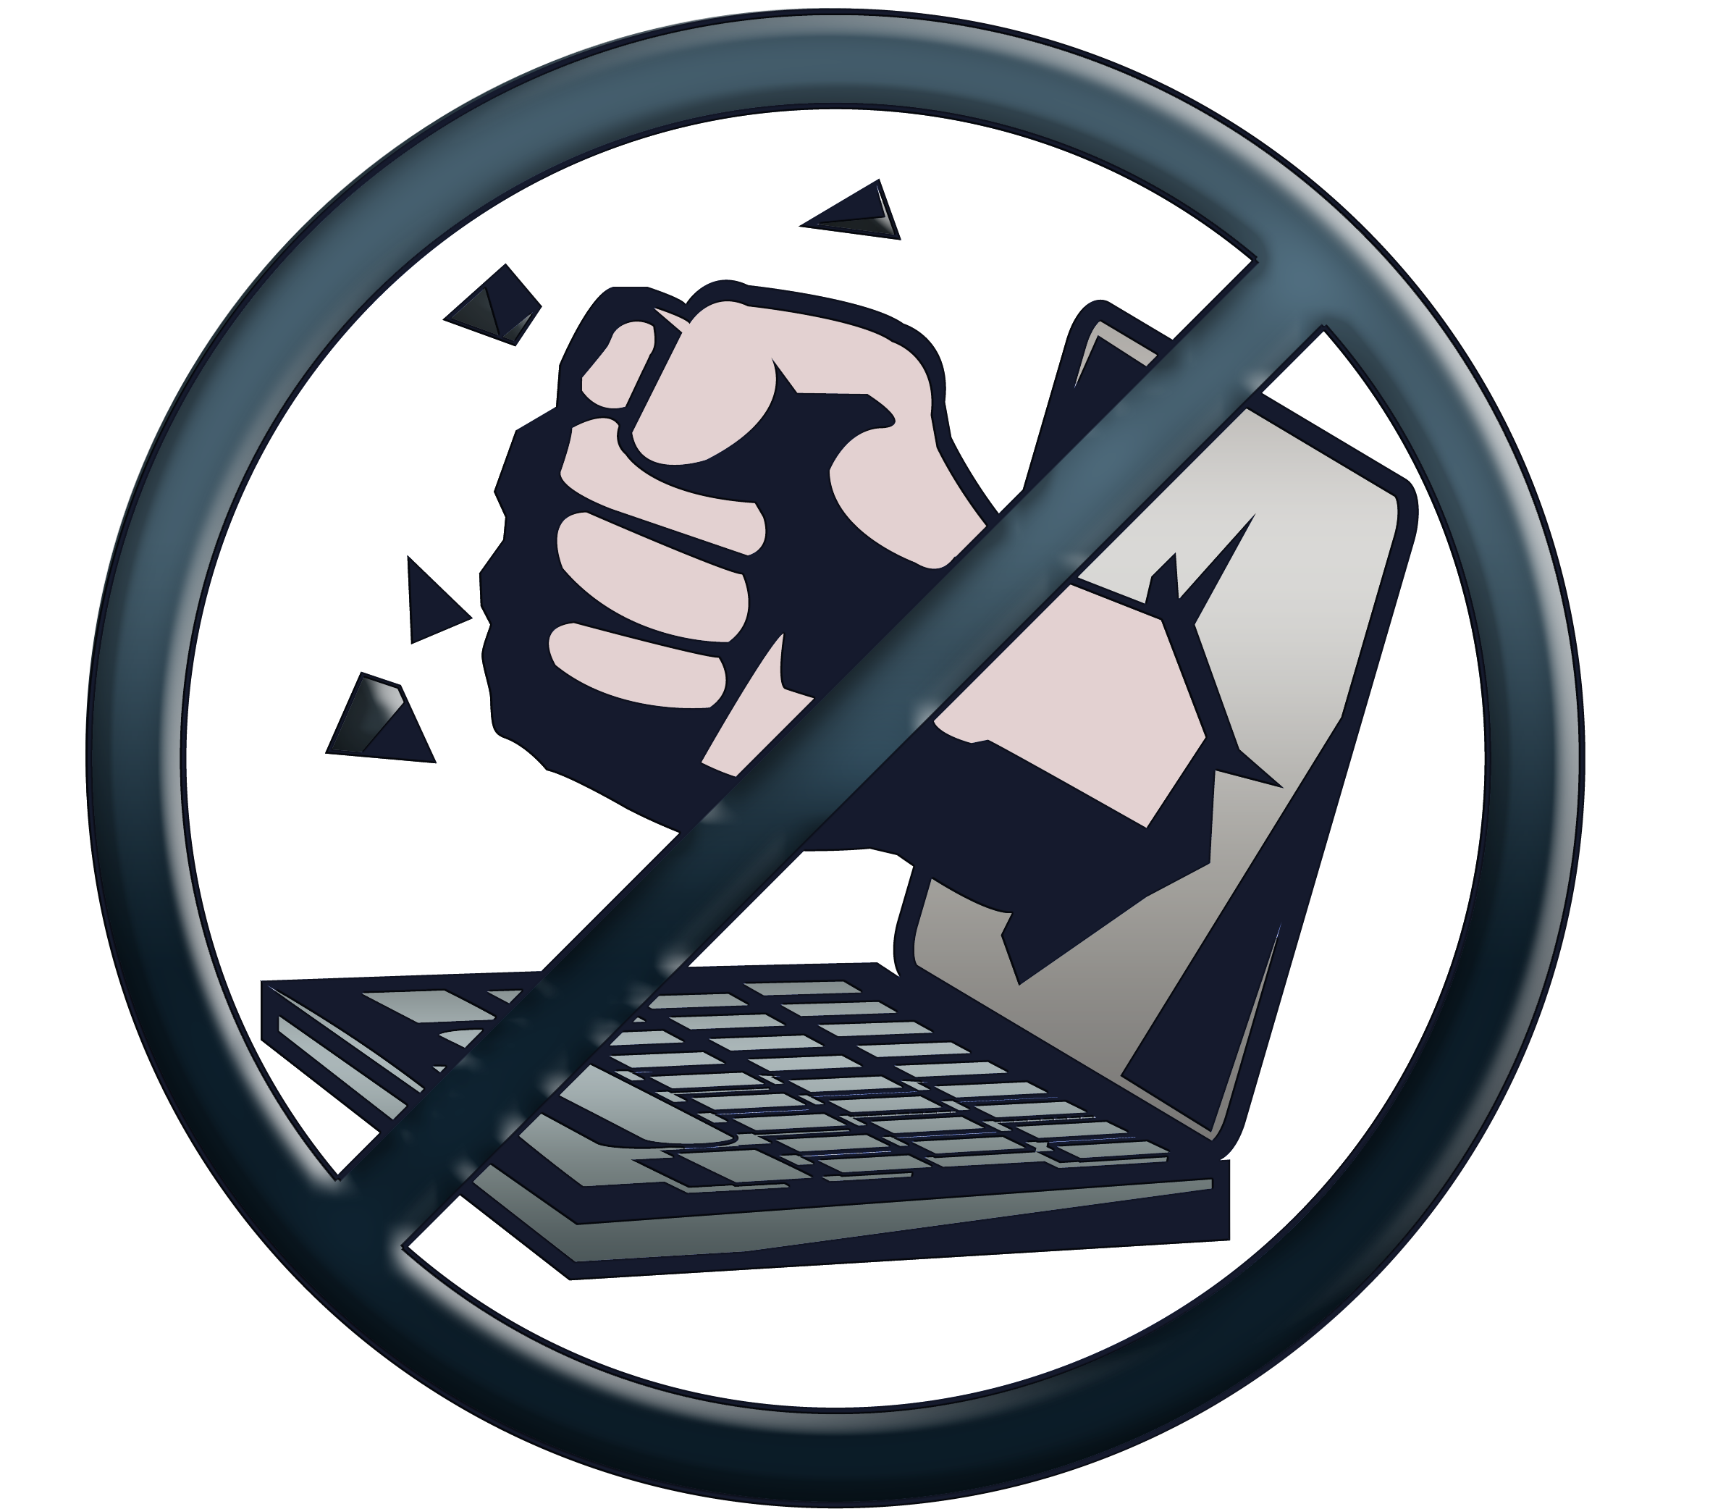

Cyber­bullying is defined as “harassing, threatening, embarrassing, or humiliating people online” through email, instant messages, phone calls or texts, and social media posts. (Christensson, 2009).
The need for individuals to have a voice and express opinions - whether for the benefit or at the cost of other has inadvertently led to a massive increase in the issue of cyber bullying / shaming.
Bullying situations usually involve more than the bully and the victim. They also involve bystanders— those who watch bullying happen or hear about it.
An important new strategy for bullying prevention focuses on the powerful role of the bystander. Depending on how bystanders respond, they can either contribute to the problem or the solution. Bystanders rarely play a completely neutral role, although they may think they do.
Notes:
How can this can be mitigated? for example: blocking or removing bad actors.
Individuals cyberbully for many reasons, but the issue is predominant in young adults. Some engage in it in order to deal with their anger, seek revenge, or make themselves appear better than their peers. Others do it for entertainment or for the pleasure of tormenting others. This is thus amplified due to anonymity aspect of the issue and while avoiding face to face contact, cyberbullies do not realize the consequences of their actions. As a result, they are more likely to say and do things they might shy away from were it an in- person interaction. Furthermore, young people are often hesitant to report cyberbullying because they are afraid that doing so will lead to restrictions on their own Internet or cell phone use or they believe nothing can be done to stop it.
Twitter’s Trust & Safety Council, supported by Anti-Bullying Pro and Feminist Frequency, was created “to ensure people can continue to express themselves freely and safely on Twitter” (Conner, 2016).

Slide 15
Summary
Freedom of speech: The conventional laws provided under the constitution are attempting to keep up with Social Media and other forms of online communication.
Validating the information presented (verify before you testify): Just because it’s said online by a large number of users does not mean the information is true. Topic research is essential to maintaining reputation and character.
Intentionally misleading the community: Posting misleading information is an effective way to validate one viewpoint. Do not follow blindly.
Notes:
Freedom of speech involves asking the following questions: Is an online presence considered private even though others have access to it? Should your employer be able to judge you professionally through your online presence?

Slide 16
Summary (cont.)
Is instant always better: Immediate gratification is the norm now. The ability to reach many instantly is both a blessing and a curse.
Privacy: If you have an online presence there is personal information about you that is being used, with or without your consent.
Verifying authors/information providers: Researching content providers is not always easy but your reputation is worth checking the source.
Anonymous posts: Rule of thumb, if a post is anonymous, the credibility is suspect.

Slide 17
Summary (cont.)
Cyber bullying/shaming: This topic has been a focal point due to high impact events such as suicides. Bullying and shaming has created online communities that try to police their own and solicit for new governance, taxonomy and legislation to assist with minimizing the impact.

Slide 18
Conclusion
Online campaigns have revolutionized the way information is organized, presented and disseminated and exponentially increased the average citizens reach and voice. A couple of ethical dilemmas are not all people have the same moral compasses and new technologies require time, effort, and resources to delineate how they should be used and what content is acceptable on specific platforms. Legislation is not keeping up with technology, so educating yourself is the best defense to ensuring you are not a victim of ignorance.

Slide 19
References
Lang, M. (2016, April 15). 2016 Presidential Election Circus: Is Social Media the Cause? Retrieved March 18, 2017, from http://www.govtech.com/social/2016 Presidential-Election-Circus-Is-Social-Media-the-Cause.html
Guides: Evaluating Information: Evaluating Social Media. (2016, November 28). Retrieved March 18, 2017 from http://guides.library.jhu.edu/c.php?g=202581&p=1335031
Greenwood, S., Perrin, A., & Duggan, M. (2016, November 11). Social Media Update 2016. Retrieved March 18, 2017, from http://www.pewinternet.org/2016/11/11/social-media-update-2016/
[CBS Pittsburgh]. (2015, June 1). Supreme Court Makes Ruling On Free Speech On Social Media. [Video File]. Retrieved from https://www.youtube.com/watch?v=jDJWCQ-ulV0.
Richter, F. (2013, February 18). Infographic: The Rise of Social Networking in the United States. Retrieved March 18, 2017, from https://www.statista.com/chart/913/the-rise-of-social-networking-in-the-united-states/
Fou, A. (2014, February, 4). Traditional Media vs. Social Media Advertising - Cost Comparison. (n.d.). Retrieved March 18, 2017, from https://www.lyfemarketing.com/traditional-media-versus-social-media/
Daly, C. (2016, June 29). Misleading social media marketing faces serious consequences, CIM warns. Retrieved March 19, 2017, from https://www.marketingtechnews.net/news/2016/jun/29/marketers-need-clean-misleading-social-media-messages-or-risk-consequences-cim-says/

Slide 20
References (cont.)
The Sad State of Social Media Privacy [Infographic]. (2012, February 21.). Retrieved March 18, 2017, from http://www.mdgadvertising.com/blog/the-sad-state-of-social-media-privacy-infographic/
Mclaughlin, E. C., & Stapleton, A. (2017, March 9). Secret Marines group is still sharing nude photos amid scandal. Retrieved from CNN Politics: http://www.cnn.com/2017/03/08/politics/marines-united-photos-investigation/
Fraley, R. (2016, February 16). The curious case of how activists are misleading people about Monsanto, Zika and microcephaly. Retrieved March 18, 2017, from https://medium.com/@MonsantoCo/the-curious-case-of-how-activists-are-misleading-people-about-monsanto-zika-and-microcephaly-b2cc776374b1#.gve72mc3j
Sedghi, A. (2015, March 10). A third of young people think social media will influence their vote. Retrieved March 19, 2017, from https://www.theguardian.com/news/datablog/2015/mar/10/a-third-of-young-people-think-social-media-will-influence-their-vote
FTC Approves Final Settlement With Facebook. (2012, August 10). Retrieved March 09, 2017, from https://www.ftc.gov/news-events/press-releases/2012/08/ftc-approves-final-settlement-facebook
Access to Social Media Usernames and Passwords. (2017, February 27). National Conference of State Legislatures. Retrieved March 09, 2017, from http://www.ncsl.org/research/telecommunications-and-information-technology/employer-access-to-social-media-passwords-2013.aspx
Christensson, P. (2009, September 15). Cyberbullying Definition. Retrieved 2017, Mar 19, from https://techterms.com

Slide 21
References (cont.)
Bosworth, B. H. (2012, December 10). ConsumerAffairs. Retrieved March 09, 2017, from https://www.consumeraffairs.com/choicepoint
DMLP Staff. (2008, June 06). Digital Media Law Project. Retrieved March 18, 2017, from http://www.dmlp.org/threats/state-indiana-v-ab#node_legal_threat_full_group_description
Bates, T. (2014, October, 01). The role of communities of practice in a digital age. (n.d.). Retrieved March 18, 2017, from http://www.tonybates.ca/2014/10/01/the-role-of-communities-of-practice-in-a-digital-age/
Samuelson, k. (2016, December 5). What to know about Pizzagate, the Fake News Story with real consequences. Time, US.
Madden, M., Lenhart, A., Cortesi, S., Gasser, U., Duggan, M., Smith, A., & Beaton, M. (2013, May 20). Teens, Social Media, and Privacy. Retrieved March 19, 2017, from http://www.pewinternet.org/2013/05/21/teens-social-media-and-privacy/
Vinjamuri, D. (2012, March 05). Ethics and the Five Deadly Sins of Social Media. Retrieved March 19, 2017, from https://www.forbes.com/sites/davidvinjamuri/2011/11/03/ethics-and-the-5-deadly-sins-of-social-media/#1838a903e1fb
Conner, D. M. (2016, March 24). The Complicated Question of Free Speech on Social Media. Retrieved March 19, 2017, from http://www.huffingtonpost.com/david-michael-conner/the-complicated-question-_b_9521454.html

